Slide 1
Unleashing the Power of Responsive Design:A Bootstrap-Powered Code Editor for
HTML CSS JS

Slide 2


Introduction
Welcome to this presentation on building a web code editor. We will explore how HTML, CSS, JavaScript, Bootstrap, and responsive design come together to create a powerful tool that enhances workﬂow, improves code clarity, and seamlessly integrates Bootstrap.
Future developments include integrating machine learning and advanced error handling.

Slide 3

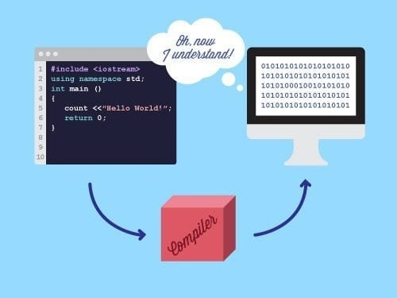
Compiler
A compiler is a specialized program that translates source code written in a high- level programming language into machine code, bytecode, or another programming language. This process allows the code to be executed by a computer's processor. Compilers perform several key functions, including lexical analysis, syntax analysis, semantic analysis, optimization, and code generation. They ensure that the source code adheres to the language's grammar rules, optimize it for better performance, and produce an executable program.

Slide 4
Tools Used:
!)HTML-Gives Strucutre(body)
2)CSS-Style(Make-up) 3)JavaScript-Logical functioning
4)Bootstrap-styling/dynamic designing 5)Vs Code
6)Github 7)Git
..........

Slide 5


BootStrap
L. Bootstrap is a popular open- source framework for developing responsive and mobile-ﬁrst websites. Created by Twitter, it provides a collection of CSS and JavaScript tools for creating consistent and visually appealing web pages. Key features of Bootstrap include:Responsive Design: Ensures your website looks good on all devices (desktops, tablets, and phones) branding and design requirements.

Slide 6

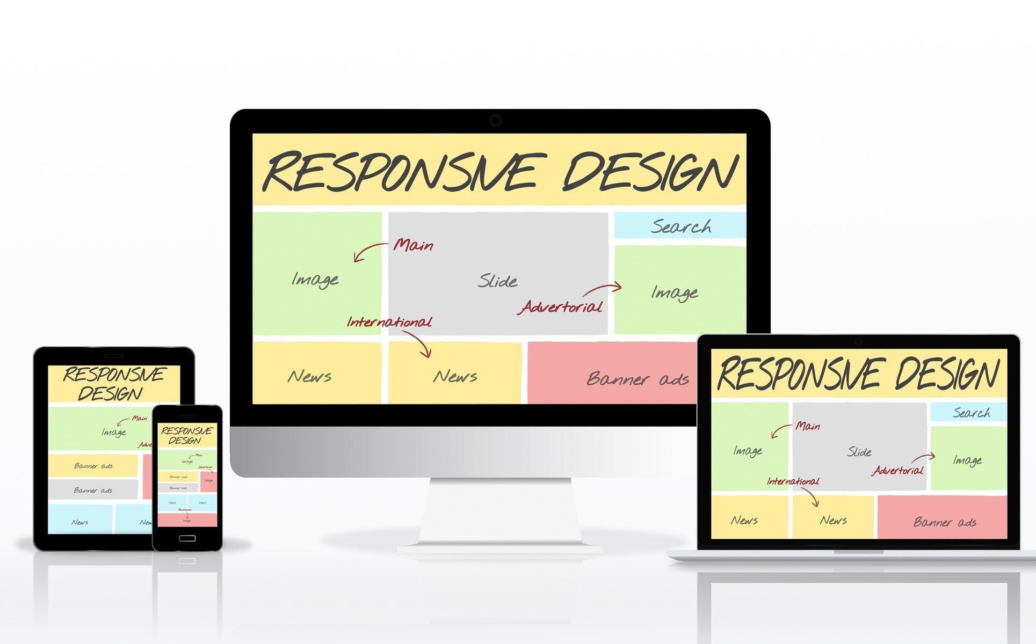
Responsiveness
Responsiveness in web design refers to the ability of a website to adapt its layout and content to various screen sizes and devices, providing an optimal viewing experience. Key aspects of responsiveness include: 1)Dynamic
2)mobile-ﬁrst design 3)Flexible Images and Media .

Slide 7

Code Explanation
Code explanation involves breaking down a piece of code to describe its functionality, logic, and purpose.
practical project :

Slide 8

Design: UI/UX
Highlight the beneﬁts of a well- designed UI/UX for developers (e.g., reduced cognitive load, faster development, fewer errors).Brieﬂy showcase speciﬁc UI/UX features planned for the editor (e.g., customizable themes, keyboard shortcuts, code folding).

Slide 9

Future Outlook
Machine Learning integration
Error Handling 3)Api integration 4)Code suggestion

Slide 10
Thanks!

